Slide 1

Steganography Project
Coded by Daniel spiering

Slide 2
What is steganography?
Steganography is the practice of concealing a message within another message or object

Slide 3
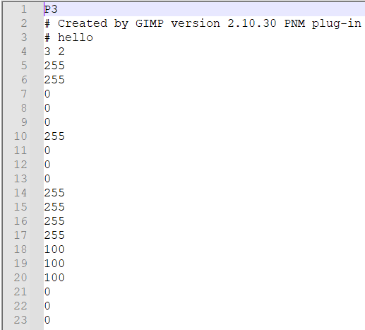
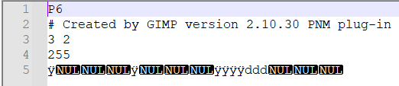
Hiding within files
P3 .ppm File
P6 .ppm File

Slide 4
Design Roadmap
Set up GUI
Load both types of ppm file
Encode a message into the file
Save the encoded image
In a second application, load and decode the message

Slide 5

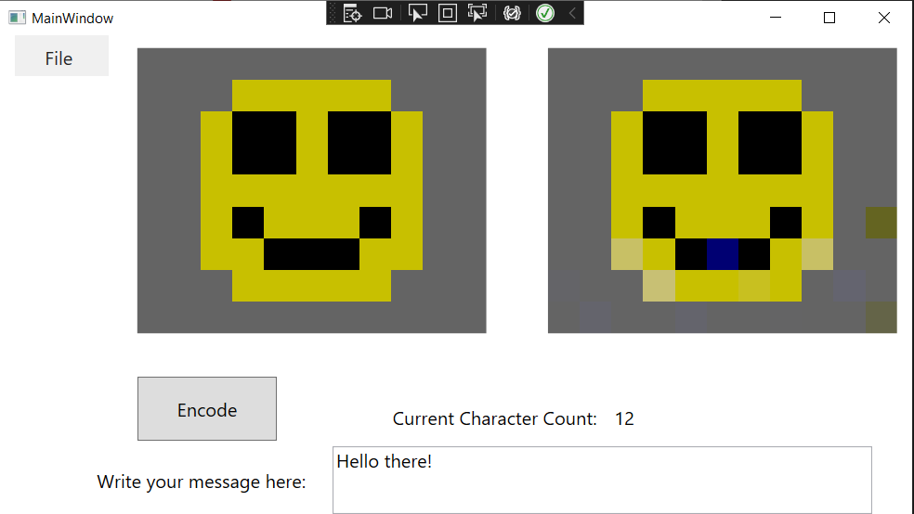
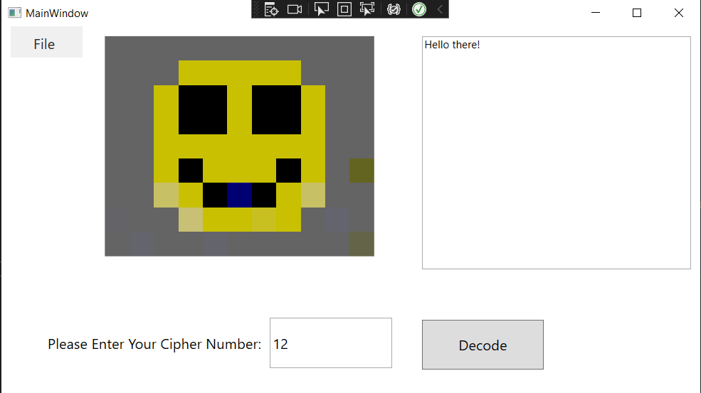
Setting up the Gui

Slide 6

Hiding the message
THINGS TO CONSIDER
Red is the most noticeable color even at long distances due to it having the longest wavelength of the visible colors
Our eyes are more sensitive to green so it stands out as the brightest color to our eyes
Hiding in the blue channel should keep any changes less noticeable than if they had been in the red or green channels
Best images to hide in will have lots of blue and black or other dark colors

Slide 7
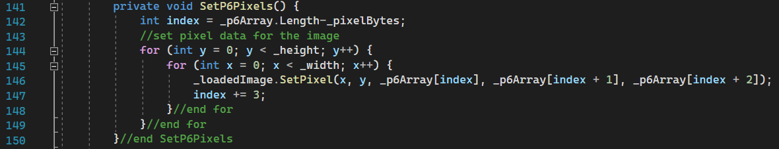
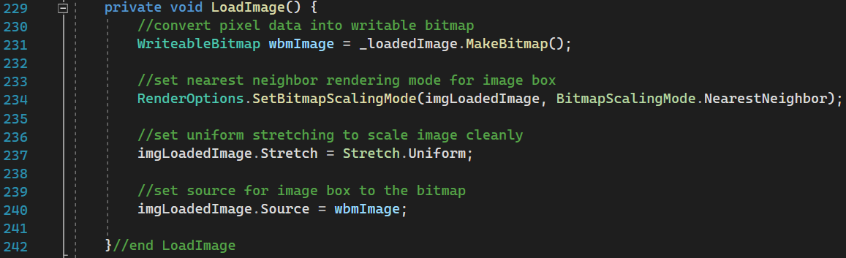
Loading ppm files: p6

Slide 8
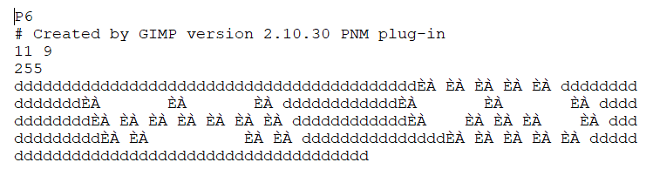
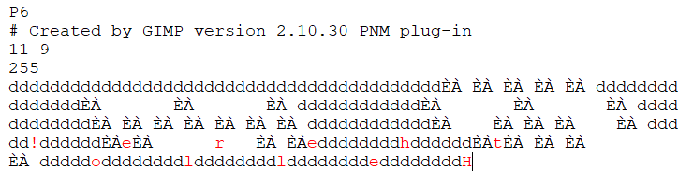
Encoding the message

Slide 9
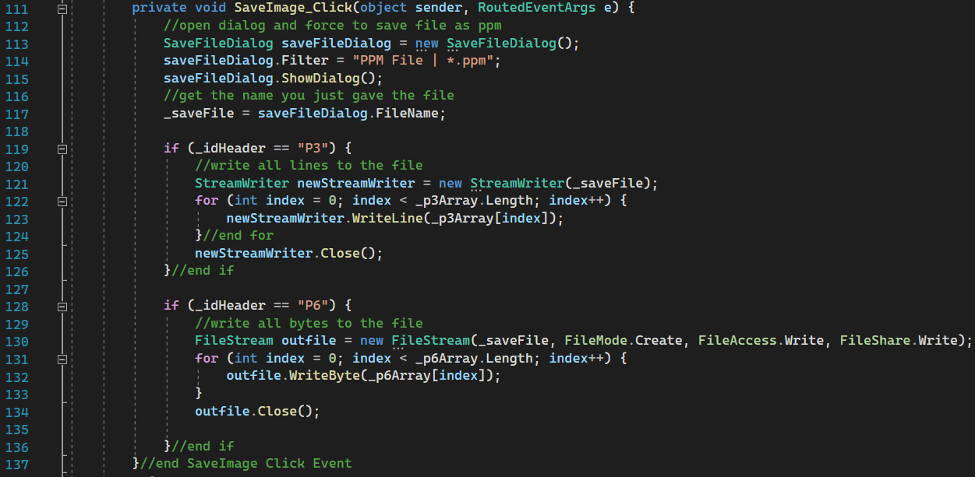
Saving the encoded image

Slide 10
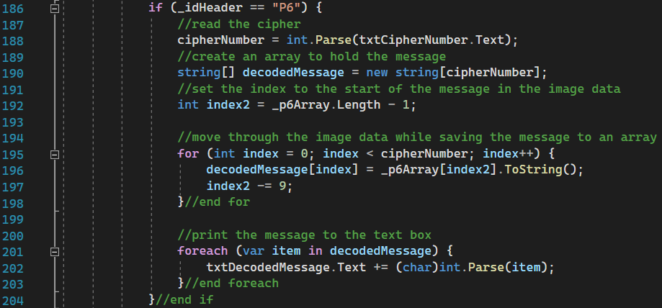
Decoding the message

Slide 11
Design hurtles
When decoding the message, it's possible someone could enter any number and reveal all or some of the message accidentally

Slide 12

Thank You
Questions?
Comments?

